Slide 1
Project # 1 Who was better? Jordan vs Bryant vs Lebron

Slide 2
Clean Data
Eliminate duplicates
Work up data
Narrow parameters down
Pts
Assists
Regular season
Playoff
Determine types of plots to make
Determine weak points
Bring in additional API’s? Outline API’s to look for?

Slide 3
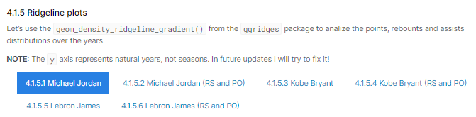
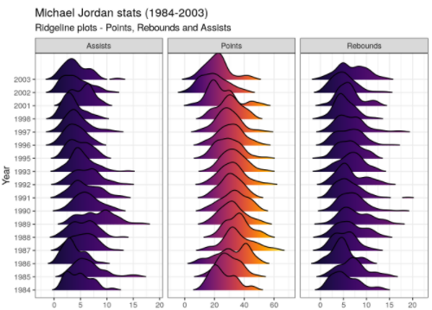
Types of data visulaizations¹…
Ridgeline Plot
Per player per
Range: first to last year
Compare
Points
Assists
% FG
Wins

Slide 4
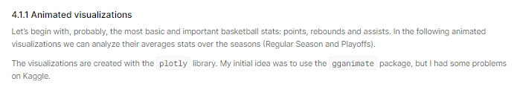
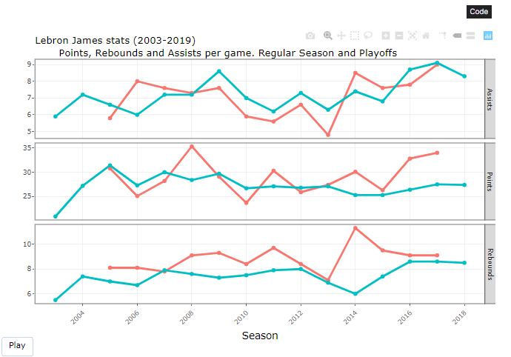
Types of data visulaizations²…
Animated visualization

Slide 5
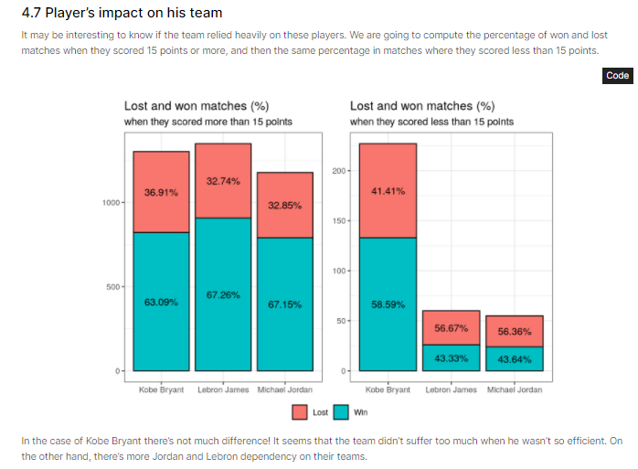
Types of data visulaizations³…

Slide 6
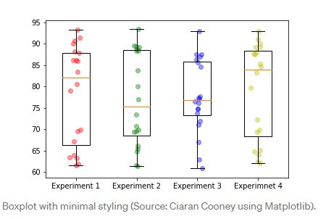
Boxplot of highest point stats
Upper 25% quartile

Slide 7
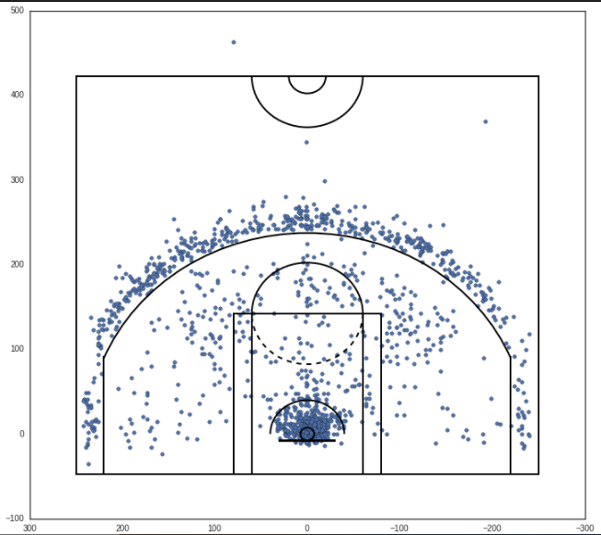
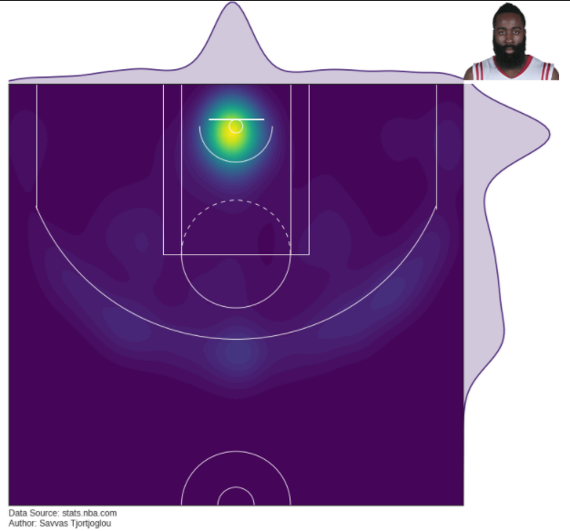
Shot Heatmap/Scatter Plot
http://savvastjortjoglou.com/nba-shot-sharts.html
https://datavizardry.com/2020/01/28/nba-shot-charts-part-1/
https://www.r-bloggers.com/2019/06/mapping-nba-shot-locations/
Where to get API?

